Slide 1
Driver Drowsiness Detection System
“You drive lousy when you are drowsy.“
Team-4 : Aaron Davis, Bhawneet Singh,
Karan Dhir, and Poonam Parag Thakur

Slide 2
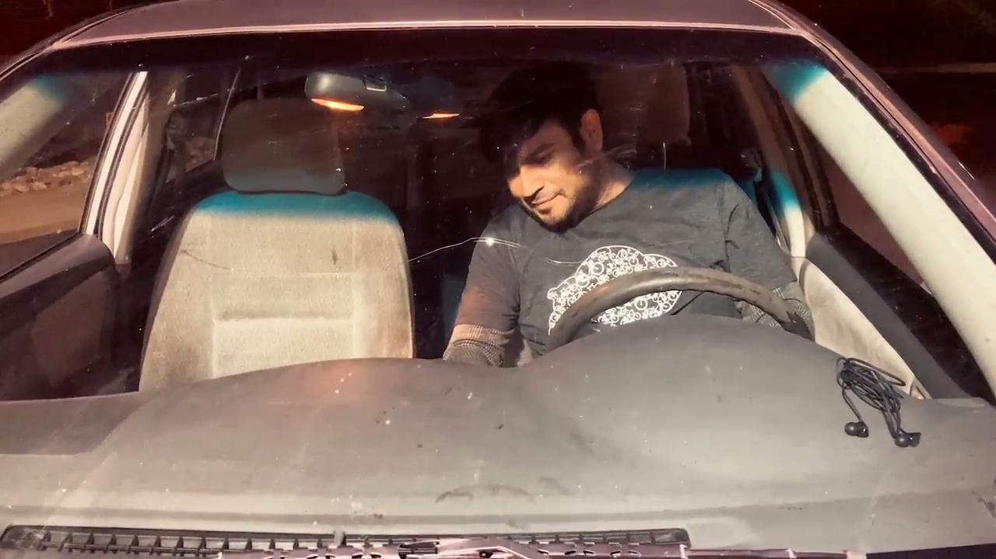
Introduction :
Drowsiness - A complex phenomenon to measure.
Reasons - Lack of sleep, medications, substance misuse, or a cerebral issue.
Other imperative factors - Mental/Physical Fatigue.

Slide 3
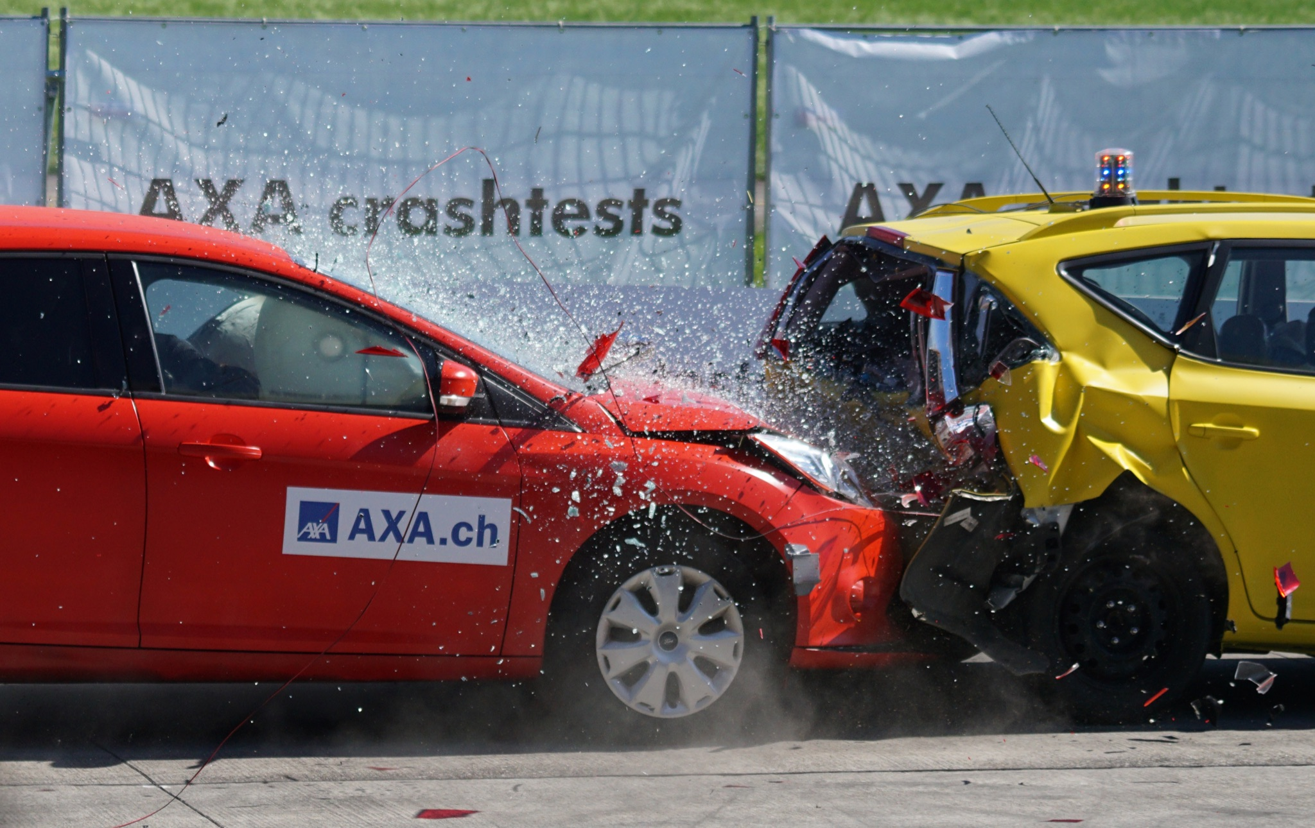
Why should you invest?
Driver fatigue is one of the major causes of vehicle accidents in the world.
According to the CDC, 4% of drivers reported falling asleep while driving in the past 30 days (as of 2009-2010).
Additionally, 16.5% of fatal crashes involved drowsy drivers.

Slide 4
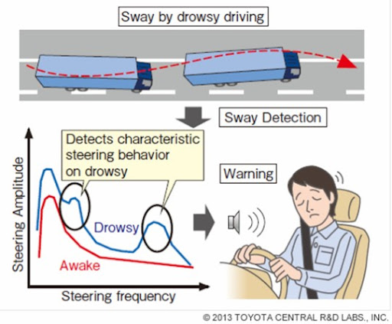
Measures for detection :
Eye closeness detection is a challenging task since there are ambient factors that affect it, as lighting condition, image resolution, driver’s position, different shape of eyes, etc.
Our real-time system will capture images continuously and measures the state of the eye, and alarms the driver if required.
Measures for detection of Drowsiness : Vehicle based measures, Physiological measures, Behavioral measures.

Slide 5
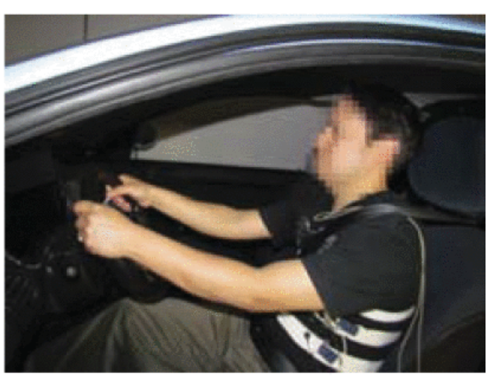
Related Work :
Detecting Drowsiness using a heart rate monitor and camera
Detecting drowsiness using respiratory analysis
Detecting drowsiness using vehicle motion metrics (e.g. steering, acceleration, braking, etc.).
Figure 1b from Related Work #2

Slide 6

Proposed Method :
In real-time, we will process a video of the driver completely on the device (not on the cloud).
Next, we will break the video into individual frames for analysis.
We will segment the images to find key facial features (e.g. eyes, mouth) using the Haar Cascade Algorithm or a convolutional neural network.
After successful feature detection, we will measure the eye aspect ratio (how open or closed the driver’s eyes are), and classify drowsiness based on that information.

Slide 7

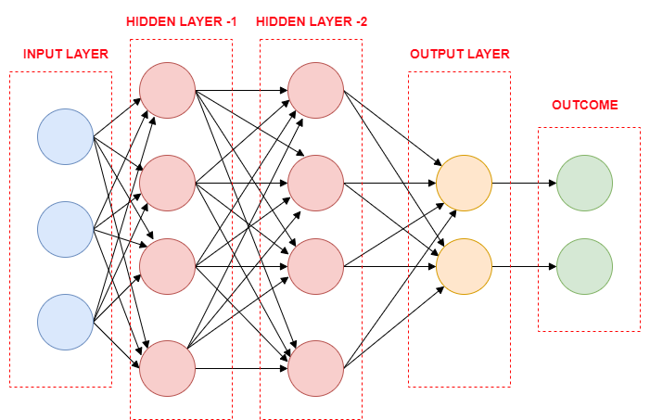
Model Architecture:
Model is built using CNN (Convoluted Neural Network) with Keras.
CNN is a special type of deep neural network which performs extremely well for image classification purposes.
CNN has an input layer, an output layer and a hidden layer that can have multiple layers.
Processing required is much lower than other classification algorithms.

Slide 8
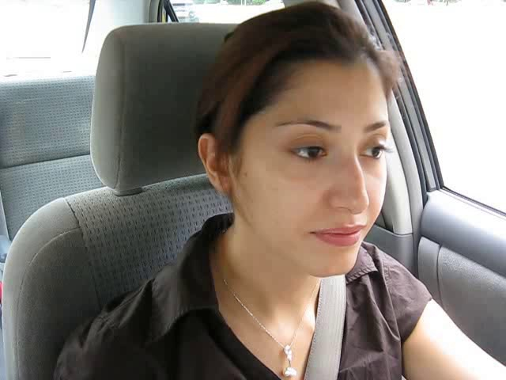
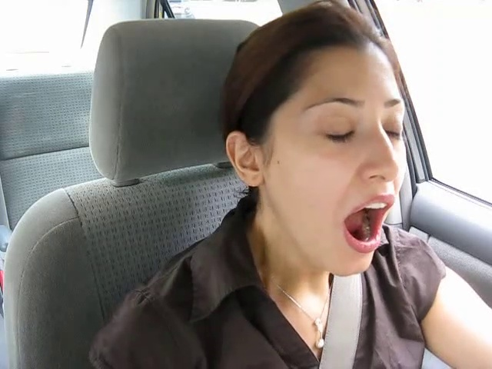
Evaluation:
AWAKE
We will evaluate our image classification model on a dataset of 450 images that were not used for model training.
After evaluating our model, we will further test our model by having it classify images in real-time video data to detect drowsiness.
Error Metrics: ROC, Precision-Recall Curve
TIRED

Slide 9
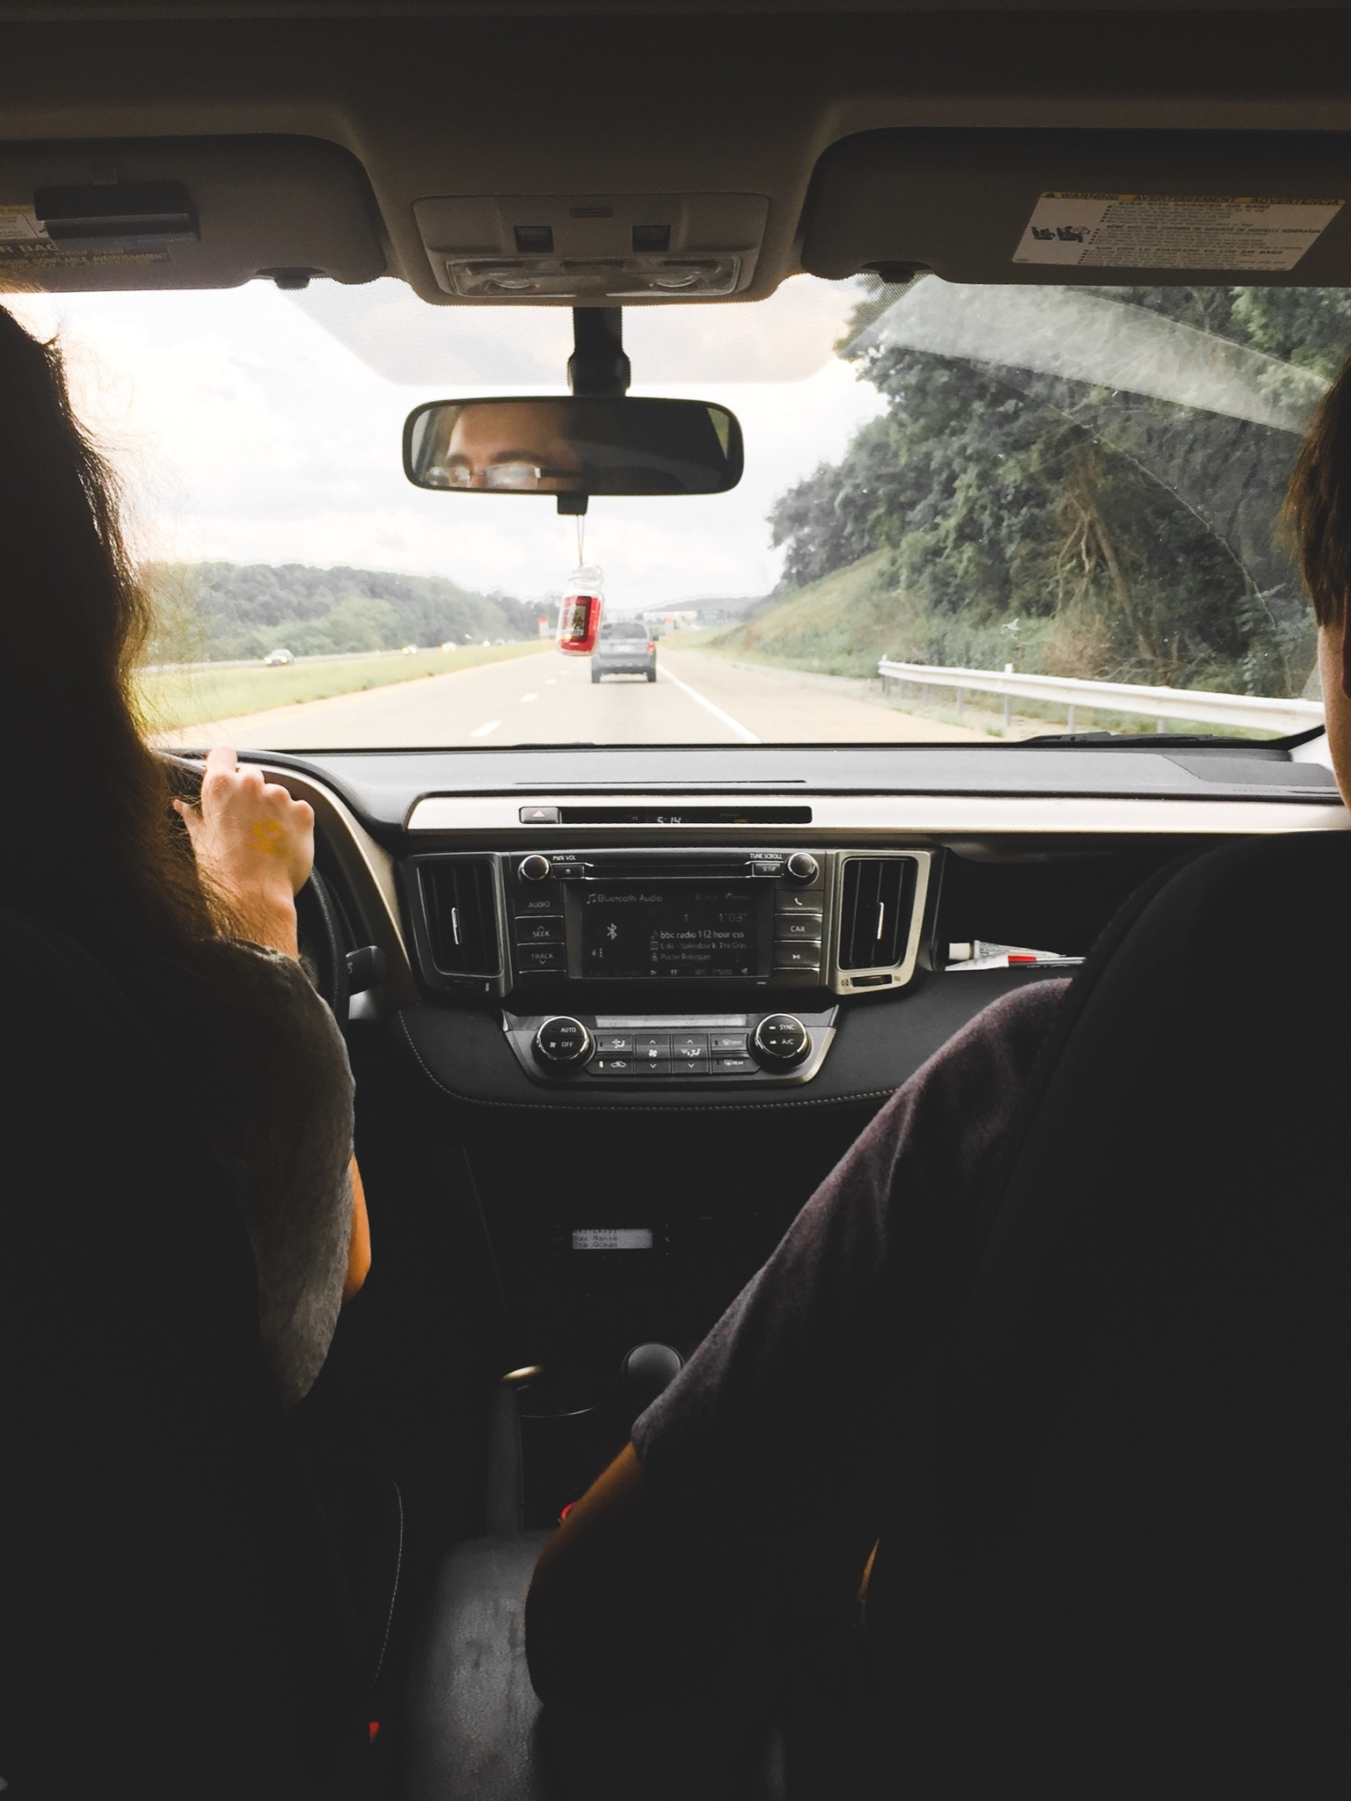
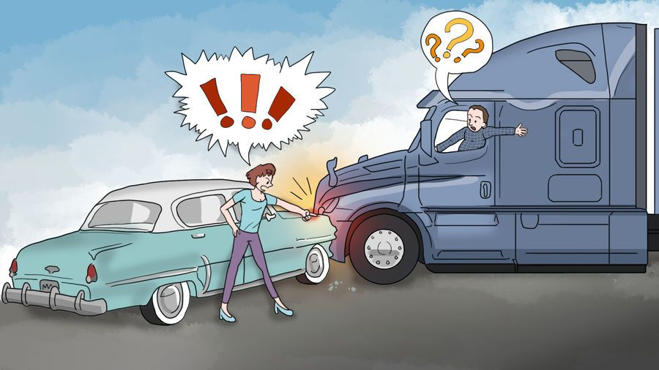
Applications :
Identify drowsy drivers and prevent them from getting in accidents.
Identify symptoms of drowsiness of operating passengers in self-driving cars, and notify the vehicle and operator of those symptoms.
Collaborate with ride-hailing modules to inform passengers about drowsy drivers when they are on-board.

Slide 10
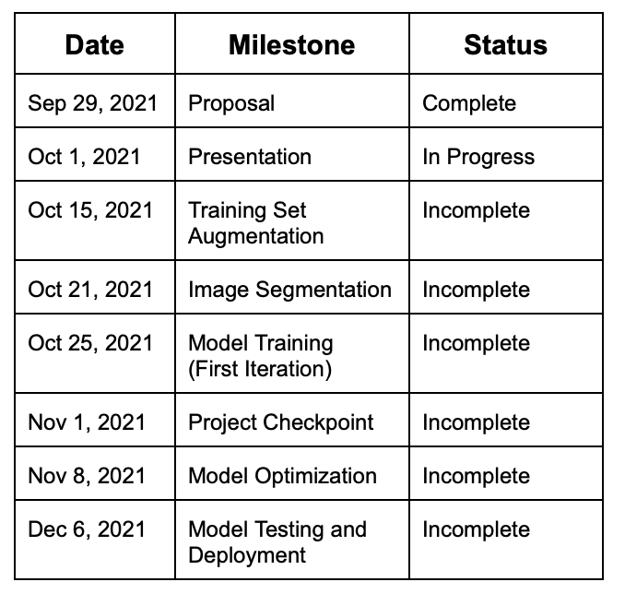
Milestones :
Week 1 - Proposal and Presentation
Week 3 - Training Set Augmentation
Week 4 - Image Segmentation
Week 5 - Model Training
Week 6-8 - Model Optimization
Week 9-10 - Model Completion and Testing

Slide 11
References :
Lakshmi Priya, B., Prithviraj, M., Baraniraj, C., & Duraikannu, P. (2018). Accident Prevention System using Driver Drowsiness Detection. International Journal of Innovative Science and Research Technology, 3(7). https://ijisrt.com/wp-content/uploads/2018/07/Accident-Prevention-System-using-Driver-Drowsiness-Detection-1.pdf
Wheaton, A., Shults, R., Chapman, D., Ford, E., & Croft, J. (2014, July 4). Drowsy Driving and Risk Behaviors — 10 States and Puerto Rico, 2011–2012. www.cdc.gov. https://www.cdc.gov/mmwr/preview/mmwrhtml/mm6326a1.htm
‌Sahayadhas, A., Sundaraj, K., & Murugappan, M. (2012). Detecting Driver Drowsiness Based on Sensors: A Review. Sensors, 12(12), 16937–16953. https://doi.org/10.3390/s121216937
‌Gupta, Sheifali & Garima, Er. (2014). Road Accident Prevention System Using Driver’s Drowsiness Detection by Combining Eye Closure and Yawning. International Journal of Research (IJR). 1. https://ijisrt.com/wp-content/uploads/2018/07/Accident-Prevention-System-using-Driver-Drowsiness-Detection-1.pdf
F. Guede-Fernández, M. Fernández-Chimeno, J. Ramos-Castro and M. A. García-González, "Driver Drowsiness Detection Based on Respiratory Signal Analysis," in IEEE Access, vol. 7, pp. 81826-81838, 2019, doi: 10.1109/ACCESS.2019.2924481.
Knipling, R., & Wierwille, W. (1994). Vehicle-based drowsy driver detection : current status and future prospects.

Slide 12
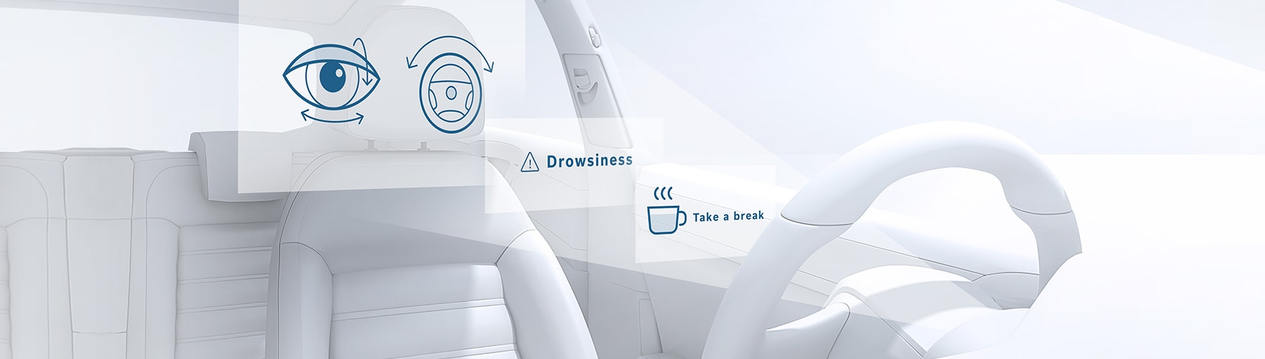
Thank You !

